Slide 1
DevOps Workshop, Part II

Slide 2
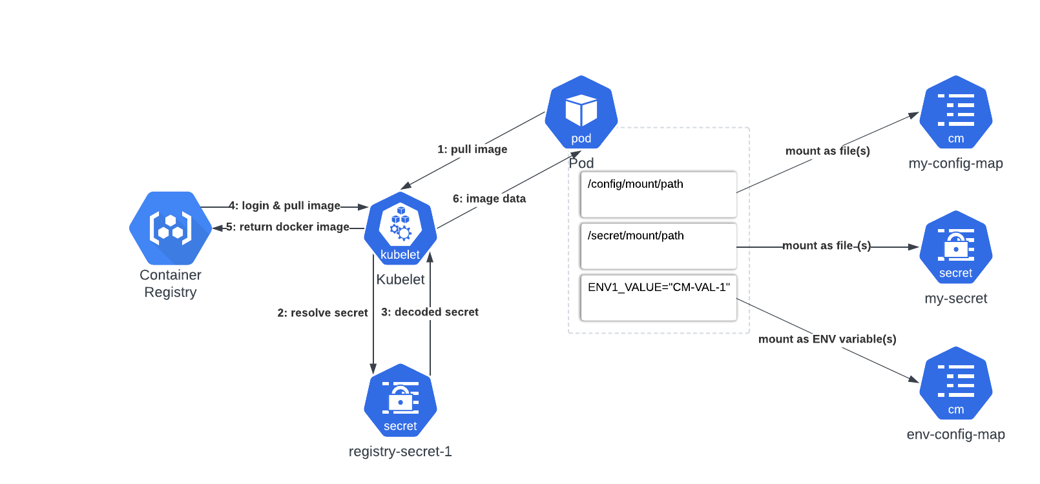
Configmaps & Secrets
WHY do we need this?
To ease configuration process.
2

Slide 3
Secret types
WHY do we need this?
To make secret purpose clearer for user.
Built-in Type | Usage
Opaque | arbitrary user-defined data
kubernetes.io/service-account-token | ServiceAccount token
kubernetes.io/dockercfg | serialized ~/.dockercfg file
kubernetes.io/dockerconfigjson | serialized ~/.docker/config.json file
kubernetes.io/tls | data for a TLS client or server
3

Slide 4


Q&A: story
WHY do we need this?
To see usecases.
I need to store DB credentials and configs somewhere… Definitely hardcoding them into docker container is not an option.
Try secrets and configmaps – they must be ideal for this purpose.
Alice
Bob
4

Slide 5
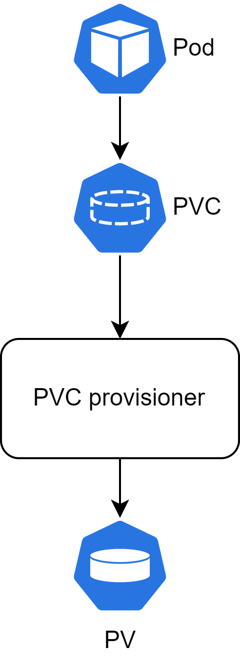
PV(C)
WHY do we need this?
To make applications stateful.
5

Slide 6
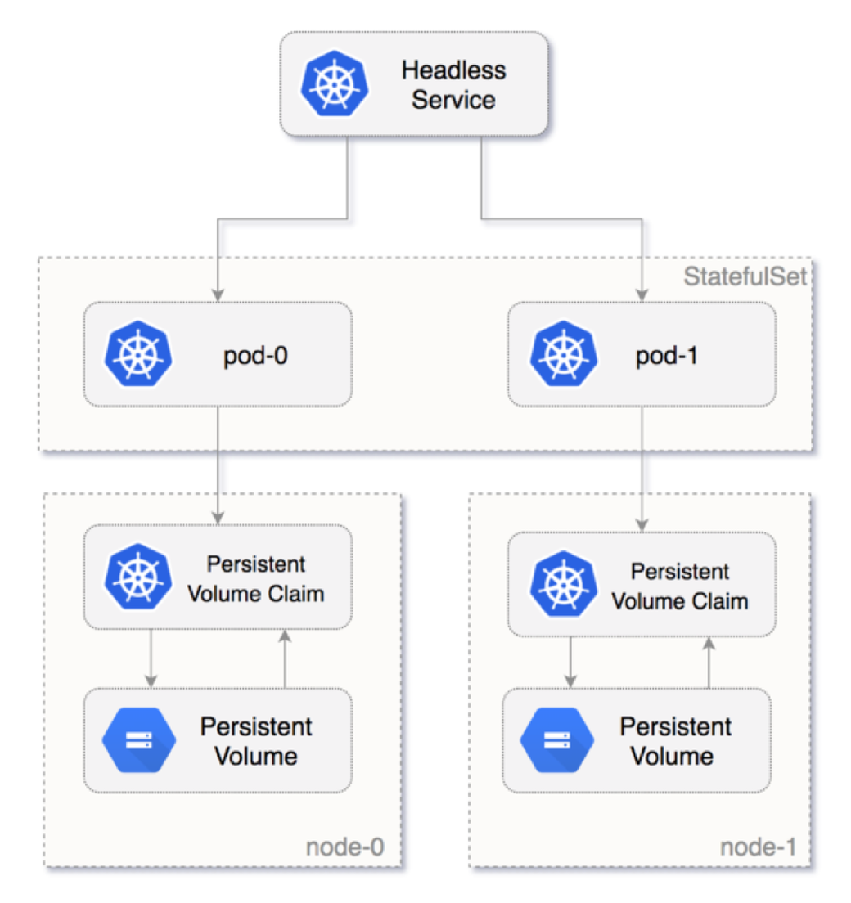
Stateful Sets
WHY do we need this?
To make stateful applications scalable.
6

Slide 7
Stateful Sets DNS
WHY do we need this?
To use cluster DNS for communication with distributed stateful applications.
Cluster Domain | Service (ns/name) | StatefulSet (ns/name) | StatefulSet Domain | Pod DNS | Pod Hostname
cluster.local | foo/nginx | foo/web | nginx.foo.svc.cluster.local | web-{0..N-1}.nginx.foo.svc.cluster.local | web-{0..N-1}
7

Slide 8
Q&A: story
WHY do we need this?
To see usecases.
My database that contains available teas can’t be stateless deployment ☹
Then make it stateful set! ☺
Alice
Bob
8

Slide 9
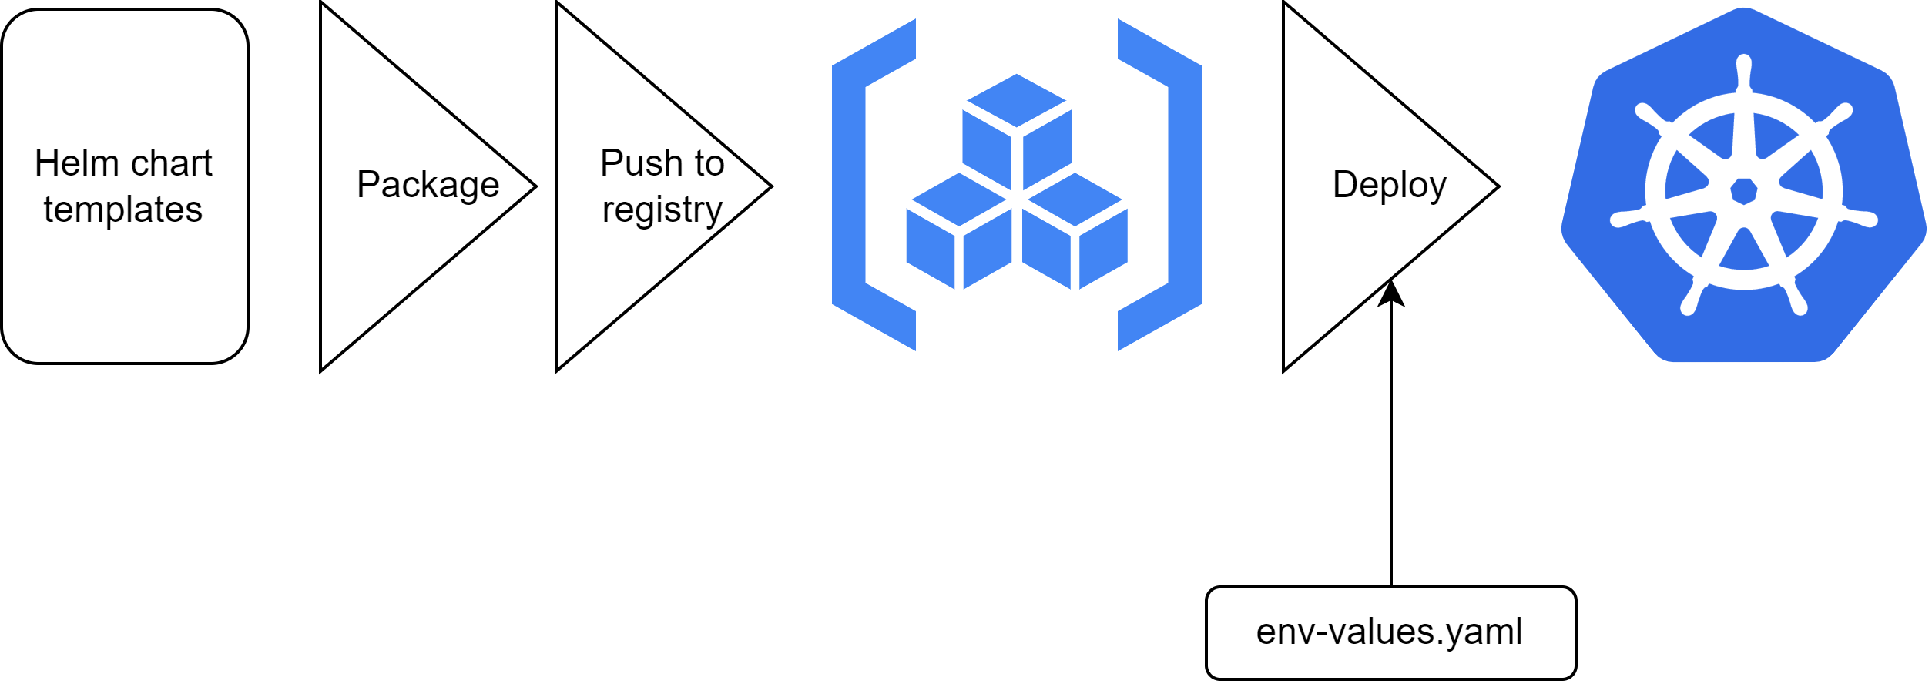
HELM
WHY do we need this?
To ease and unify deployment configuration for different envs.
9

Slide 10
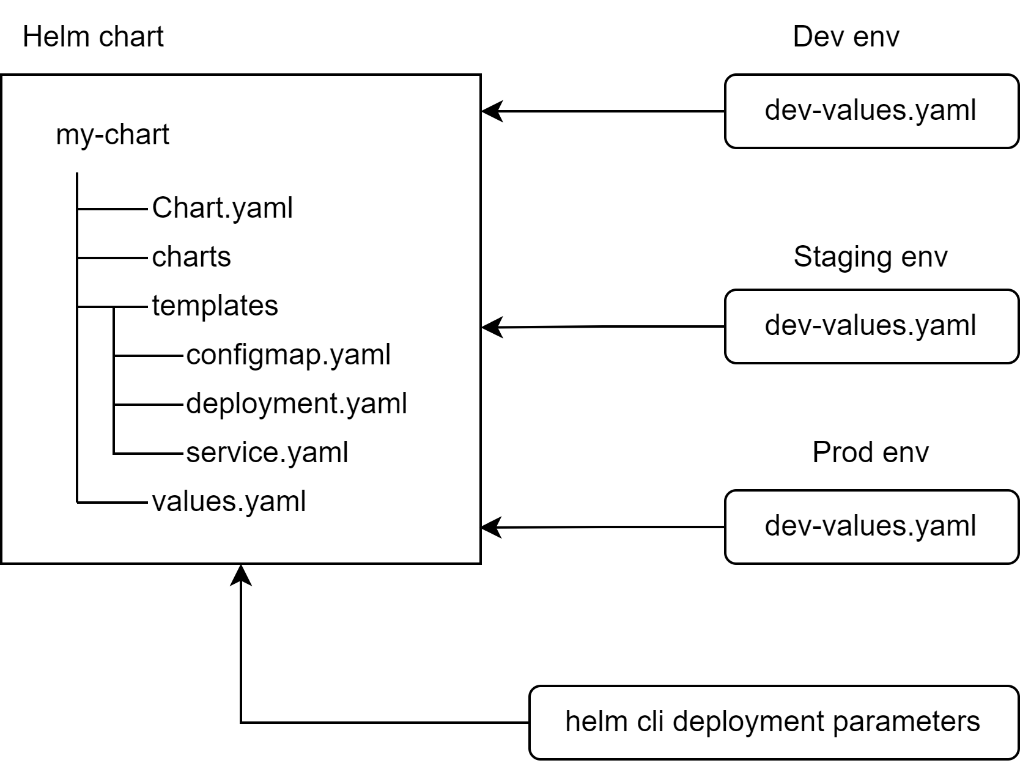
HELM Layout
WHY do we need this?
To ease and unify deployment configuration for different envs.
10

Slide 11
HELM Templating
WHY do we need this?
To ease and unify deployment configuration for different envs.
Template service.yaml
values.yaml
apiVersion: v1
kind: Service
metadata:
name: {{ include "my-chart.fullname" . }}
labels:
{{- include "my-chart.labels" . | nindent 4 }}
spec:
type: {{ .Values.service.type }}
ports:
- port: {{ .Values.service.port }}
targetPort: http
protocol: TCP
name: http
selector:
{{- include "my-chart.selectorLabels" . | nindent 4 }}
replicaCount: 1
image:
repository: nginx
service:
type: ClusterIP
port: 80
11

Slide 12
HELM Templating
WHY do we need this?
To ease and unify deployment configuration for different envs.
helm template my-release-name my-chart/
12

Slide 13
HELM Templating
WHY do we need this?
To ease and unify deployment configuration for different envs.
Template service.yaml
service.yaml
apiVersion: v1
kind: Service
metadata:
name: my-release-name-my-chart
labels:
helm.sh/chart: my-chart-0.1.0
app.kubernetes.io/name: my-chart
app.kubernetes.io/instance: my-release-name
app.kubernetes.io/version: "1.16.0"
app.kubernetes.io/managed-by: Helm
spec:
type: ClusterIP
ports:
- port: 80
targetPort: http
protocol: TCP
name: http
selector:
app.kubernetes.io/name: my-chart
app.kubernetes.io/instance: my-release-name
apiVersion: v1
kind: Service
metadata:
name: {{ include "my-chart.fullname" . }}
labels:
{{- include "my-chart.labels" . | nindent 4 }}
spec:
type: {{ .Values.service.type }}
ports:
- port: {{ .Values.service.port }}
targetPort: http
protocol: TCP
name: http
selector:
{{- include "my-chart.selectorLabels" . | nindent 4 }}
13

Slide 14
Q&A: story
WHY do we need this?
To see usecases.
Well, now I have my tea shop running, but development requires different environments with different configuration…
Give helm a chance!
Alice
Bob
14

